Slide 1
Wisconsin Sexually Transmitted Infections (STIs) Surveillance Data Reported Cases in 2023
P-00415 (09/2024)
Notes:
This slide set is prepared by the Sexually Transmitted Infections (STIs) Intervention Unit, Bureau of Communicable Diseases, Division of Public Health Wisconsin Department of Health Services.
These slides display trends and burden of reported cases of STIs across different age groups, sexes, racial/ethnic groups and geographic regions in Wisconsin over the past five years (2019-2023).

Slide 2
Introduction
Reportable Sexually Transmitted Infections (STIs) in Wisconsin:
Chlamydia trachomatis (Chlamydia) — Includes disease classifications such as urethritis, cervicitis and conjunctivitis.
Neisseria gonorrhoeae (Gonorrhea) — Includes disease classifications such as urethritis, cervicitis, and resistant strains. Resistant or reduced susceptibility to antibiotic treatment are confirmed by antibiotic susceptibility testing (AST).
Treponema pallidum (Syphilis ) — Wisconsin data includes all stages and CDC data includes primary and secondary stages of syphilis.
Notes:
This set of slides focuses on three of the most prevalent STIs: Chlamydia, gonorrhea, and syphilis, examining the burden defined by age, sex, and race. National, state, and county-level trends will be discussed. Analyses related to syphilis differ from those of other STIs. Specifically, for age, sex, and race, only primary and secondary cases of syphilis were selected for analysis.

Slide 3
Introduction
Sexually transmitted infections (STIs) surveillance data are collected systematically through WEDSS* for the purpose of monitoring the frequency and distribution of STIs in the Wisconsin population.
This analysis examines trends in reportable STIs in Wisconsin to identify problem areas and allocate resources for effective STI interventions.
Out of state, cases from correctional facilities, and unknown states are not included.
Rates are calculated based on 2020 population data available in Wisconsin Interactive Statistics on Health (WISH) population module.
*WEDSS is a secure, web-based system designed to facilitate reporting, investigation, and surveillance of communicable diseases in Wisconsin. It is designed for public health staff, infection control practitioners, clinical laboratories, clinics, and other disease reporters.
Notes:
Our data were sourced from WEDSS and included all reported STIs within Wisconsin. The forthcoming analysis incorporates all cases among Wisconsin residents, excluding those from out-of-state or with unknown states of residence. For analyses, only confirmed cases of gonorrhea and chlamydia were included, while both probable and confirmed cases of syphilis were included.

Slide 4
Interpret STIs Surveillance Data With Caution
STI data may be underreported, unevenly reported, and incomplete.
Elements that impact the completeness and accuracy of STI data include:
Practices and capacity of STI screening by health care providers.
Health care providers’ compliance with case reporting.
Completeness and promptness of case reporting.
COVID-19 may have influenced the number of cases diagnosed and reported in 2020 and 2021.
Notes:
Data quality poses a significant concern when analyzing STI data, stemming from factors such as underreporting and incomplete patient records. Additionally, the emergence of COVID-19 has introduced new challenges, including disruptions to testing practices. The increased strain on the health system during the pandemic may have further exacerbated issues with data quality and access to testing services for the public. Considering these limitations, the Department of Health Services (DHS) recommends exercising caution when interpreting surveillance data.

Slide 5
Health Equity Considerations
STIs can affect anyone; however, some communities have much higher rates of infection than others. These disparities are not due to behavioral practices alone. There are many different social conditions, policies, and systemic practices that put some people at higher risk for STIs, such as:
Racism
Discrimination
Oppression
Poverty
Lack of access to sexual health education
Lack of access to health care
Stigma
Notes:
Data quality poses a significant concern when analyzing STI data, stemming from factors such as underreporting and incomplete patient records. Additionally, the emergence of COVID-19 has introduced new challenges, including disruptions to testing practices. The increased strain on the health system during the pandemic may have further exacerbated issues with data quality and access to testing services for the public. Considering these limitations, the Department of Health Services (DHS) recommends exercising caution when interpreting surveillance data.

Slide 6
How Does Wisconsin Compare to Neighboring States?
Notes:
The next three slides display the comparison of 2022 STI rates among neighboring states and for the United States as a whole. At this point in time, 2023 STI rates are not available for all neighboring states, leading us to use 2022 rates instead.

Slide 7
Wisconsin ranked highest among its neighboring states for primary and secondary syphilis rates per 100,000 people in 2022.
Notes:
In 2022, Wisconsin had the highest rate of primary and secondary syphilis among its neighboring states, with a rate of 12.6 cases per 100,000 people, but was lower than national rate (17.7 cases per 100,000 people).

Slide 8
Wisconsin Ranked Third Among Neighboring States for Gonorrhea Rates per 100,000 People in 2022
Notes:
In 2022, Wisconsin had a lower rate of gonorrhea with a rate of 148.3 cases per 100,000 people than the national rate at 194.4 cases per 100,000 people. Wisconsin’s rate was comparable to other Midwestern states.

Slide 9
Wisconsin Ranked Third Among Neighboring States for Chlamydia Rates per 100,000 People in 2022
Notes:
In 2022, Wisconsin had a lower rate of chlamydia with a rate of 435.7 cases per 100,000 people than the national rate of 495.0 cases per 100,000 people. The Wisconsin rate was comparable to other Midwestern states.

Slide 10
Reported Cases of Sexually Transmitted Infections in Wisconsin– 2023
Notes:
The next part of these slides will quantify the burden of STIs in Wisconsin and examine how trends in STI incidence have changed over time.

Slide 11
STIs are Widespread in Wisconsin
A total of 33,791 cases of sexually transmitted infections were reported in 2023. Reportable STIs include gonorrhea, chlamydia, and syphilis.
Notes:
In 2023, a total of 33,791 cases of STIs (syphilis, gonorrhea, and chlamydia) were reported in Wisconsin, which is 6.9% decrease compared to the total number of STI cases reported in 2022 (36,299 cases).

Slide 12
STI Cases Have Increased Since 2014 Trend of reported STI cases, 2014–2023
+24.6%
+24.4%
Notes:
This slide illustrates the trend of sexually transmitted infections (STIs) from 2014-2023. Over this period, the number of reported cases of STIs increased by 24.6% .

Slide 13
STI Cases Have Been Declining Since 2021 Trend of reported STI cases, 2014–2023
Notes:
This slide illustrates the trend of sexually transmitted infections (STIs) from 2014-2023.
Although the number of reported STI cases increased by 24.6% from 2014 to 2023, the number of cases has been declining since 2021. The data indicates a 15.4% decrease in the number of cases in 2023 from 2021 (39,957 in 2021 to 33,791 cases in 2023). This period marks the third consecutive year of decline in reported STI cases, suggesting a sustained downward trend over time.

Slide 14
The Rate of STIs Has Increased Since 2014 Trend of STI rates per 100,000 people in Wisconsin, 2014–2023
+18.6%
Note: Excludes out of states cases.
Notes:
This slide illustrates the trend of sexually transmitted infections (STIs) rates from 2014-2023. Over this period, the rates of reported cases of STIs increased by 18.6% .

Slide 15
Of the 33,791 STI cases reported in 2023, Chlamydia accounted for 74% by followed by gonorrhea at 21% and syphilis at 5%. Number of Sexually Transmitted Infections Reported in Wisconsin, 2023
Chlamydia was the Most Commonly Reported STI
Note: Includes all (Wisconsin, out of jurisdiction cases and correctional cases) reported cases.
Notes:
Of the 33,791 STI cases reported in 2023, Chlamydia accounted for 74% by followed by gonorrhea at 21% and syphilis at 5%. Chlamydia is the most reported sexually transmitted infection in Wisconsin, followed by gonorrhea and syphilis.

Slide 16
Syphilis
Notes:
The next 20 slides discuss about the trend and burden of syphilis by age, sex, racial/ethnic groups and geographic regions.

Slide 17
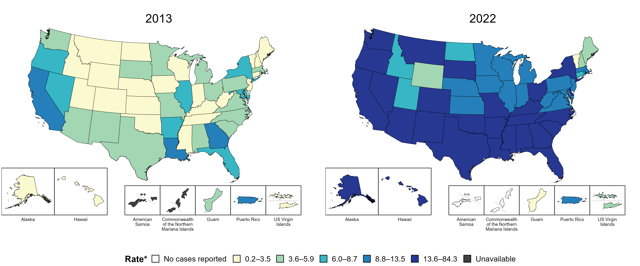
Primary and Secondary Syphilis — Rates of Reported Cases by Jurisdiction, United States and Territories, 2013 and 2022
* Per 100,000
Notes:
In 2013, three states, the District of Columbia (DC), and one US territory (9.3% of areas with available data) had a rate of reported primary and secondary syphilis greater than or equal to 8.8 cases per 100,000 population. This increased to 42 states, DC, and one US territory (78.6% of areas with available data) in 2022.
American Samoa and the Commonwealth of the Northern Mariana Islands began reporting data on primary and secondary syphilis cases to CDC in 2018; data are not available for those areas prior to that year.
This slide includes data from years that coincide with the COVID-19 pandemic, which introduced uncertainty and difficulty in interpreting STI surveillance data.
See Technical Notes (https://www.cdc.gov/std/statistics/2022/technical-notes.htm) for information on syphilis case reporting and on interpreting reported rates in US territories.
Data for all figures are available at https://www.cdc.gov/std/statistics/2022/data.zip. The file “PS Syphilis - Rates by Jurisdiction (US and Terr 2013 and 2022).xlsx” contains the data for the figure presented on this slide.

Slide 18
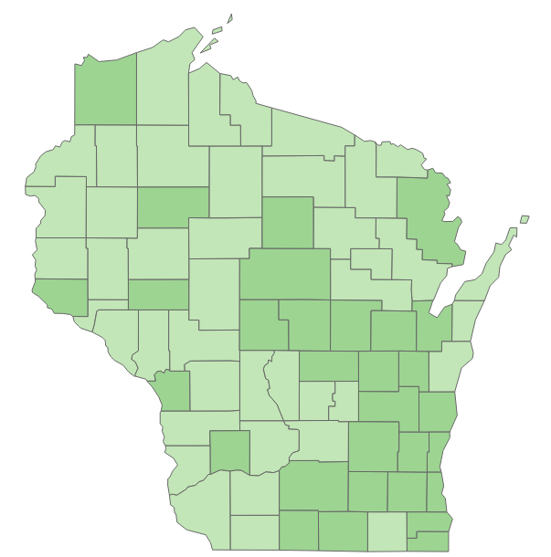
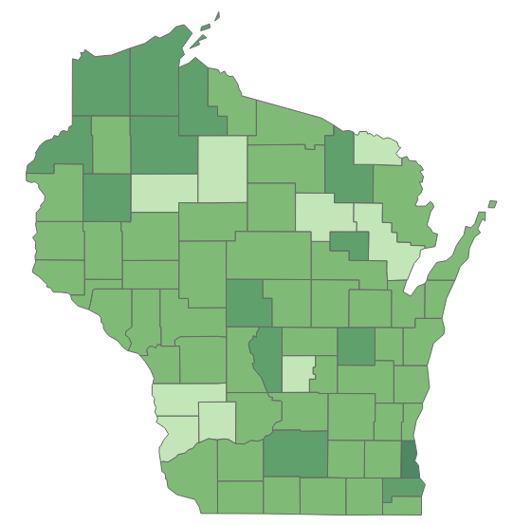
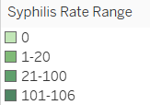
Syphilis Rates Increased in More Wisconsin Counties in 2023 compared to 2013
2013
2023
Notes:
Since 2013, the geographic spread of primary and secondary syphilis in Wisconsin has significantly increased.
In 2013, 30 out of 72 counties in Wisconsin had a primary and secondary rate of one or more cases per 100,000 people. By 2023, this number had risen to 63 counties. This indicates a notable expansion of syphilis across the state over the past decade.

Slide 19
Syphilis is the Least Common Reported STI
A total of 1,794 cases of syphilis (all stages including congenital) were reported in 2023.
Notes:
In 2023, a total of 1,794 cases of syphilis (all stages including congenital) were reported reflecting a 6.4% decrease compared to 2022 (1,916 cases).

Slide 20
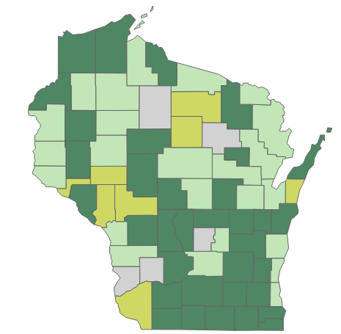
Reported Number of Syphilis Cases Increased in 35 Wisconsin Counties from 2022 to 2023
Notes:
Compared to 2022, in 2023:
49% (35/72) of Wisconsin counties, indicated by a dark green color, showed an increase in reported syphilis cases.
33% (24/72) of Wisconsin counties, indicated by a light green color, showed a decrease in reported syphilis cases.
11% (11/72) of Wisconsin counties, indicated by a lime green color, showed no change in reported syphilis cases.
7% (5/72) of Wisconsin counties, indicated by a gray color, reported zero syphilis cases in 2023.

Slide 21
Rate of Syphilis (All stages) Decreased 9% in from 2022 to 2023 in Wisconsin. Trends of Syphilis cases and rates per 100,00 people, Wisconsin 2014–2023
Notes:
This slide highlights the reported cases and rates of syphilis over the past decade. The green bars represent the number of syphilis cases reported each year, while the orange line displays the rates of syphilis over the years. As shown here, there was a drastic increase in syphilis (all stages including congenital) rates from 2020 to 2021 (from 14 to 28 per 100,000). The rate continued to increase until 2022 but declined by 9% in 2023.

Slide 22
Syphilis Rate Has Increased 200% Since 2019 Rates of syphilis per 100,000 people, Wisconsin, 2019–2023
Notes:
This slide displays the rates of reported cases of syphilis over the past five years in Wisconsin.
The rate increased until 2022; however, it decreased by 9.1% in 2023, making the first decrease in the past five years.

Slide 23
Rates of Syphilis Decreased in Both Males and Females From 2022 to 2023
Rate of primary and secondary syphilis diagnoses per 100,000 people, Wisconsin, 2019–2023
Male
Female
Notes:
This slide displays the syphilis rates trend among Wisconsin males and females for past five years.
In 2023, syphilis rates remained higher among men then women, with males having a rate 3.5 times higher than females. However, both genders experienced a decrease in syphilis rates compared to 2022, with a 26.3% reduction among males and 42.3% reduction among females. This downward trend in syphilis rates observed since 2022 for both men and women.

Slide 24
The Rate of Primary and Secondary Syphilis Increased With the Onset of COVID-19 then Remained Steady for a Year and Dropped in 2023
Late latent
Primary & Secondary
Notes:
This slide indicates the rates of primary and secondary and late latent stage. The orange line displays the rates of primary and secondary syphilis over the period and the gray line displays the rates of late latent stage of syphilis over the time. The rates of primary and secondary syphilis increased with the onset of Covid-19 and remained stable for a year and has declined in 2023. The rate of late latent stage of syphilis has increased 15.4% in 2023 compared to 2022.

Slide 25
Overall Trends in Primary and Secondary Syphilis Rates by Age Groups
Rates of syphilis per 100,000 people by age in Wisconsin,2019–2023
15–19
years
20–29
years
30–39
years
40–49
years
Notes:
This slide illustrates primary and secondary syphilis rates across different age groups in Wisconsin. Traditionally, older age groups have exhibited higher syphilis rates. There was an increase in syphilis rates coinciding with the onset of COVID-19. However, from 2022 to 2023 syphilis rates decreased across almost all age groups, with most significant reduction observed in people aged 40-49 years.

Slide 26
The Syphilis Rate Has Historically Been Higher Among Black People
Rate of syphilis diagnoses per 100,000 people by race, Wisconsin: 2019–2023
Black
Native American
Hispanic
White,
Asian
Notes:
This slide presents the syphilis rates among different racial ethnic groups in Wisconsin. Historically, syphilis rates have been higher among Black people. In 2023, the rate among Black people declined for the first time since 2019. Native American people saw a 52% decrease in syphilis rates from 2022 to 2023, while the rate among White people remained unchanged during the same period.

Slide 27
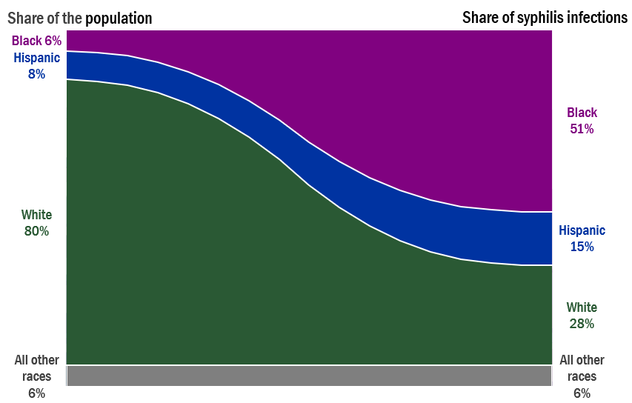
Black and Hispanic people are disproportionately affected by Syphilis infections
Black and Hispanic People are Disproportionately Impacted by Syphilis
Notes:
The slide highlights the disproportionate burden of syphilis infections among racial and ethnic groups in Wisconsin.
Despite representing only 6% of the total population, Black people accounts for 51% syphilis infections. Conversely, White people, who constitute 80% of the population, exhibits only 28% burden of syphilis infections.
The percentages of syphilis cases by non-Hispanic ethnicities were disproportionate to the percentages among the total population of the United States in 2023.
The most significant disparities were observed among non-Hispanic Black people, who represented 51.0% of reported syphilis cases (n = 1,794) despite being 12.6% of the US population.

Slide 28
Rates of Syphilis (All Stages) Are Higher in The Southeastern Region Rates of reported cases of syphilis by regions, 2019–2023.
Southeastern
Southern
Northeastern
Western
Northern
Notes:
This slide displays the syphilis burden trend across five regions of Wisconsin.
The southeastern region consistently exhibited the highest syphilis rate compared to other regions. Notably, in 2023, the southeastern region experienced its first decline in syphilis rates in five years, compared to 2022 (66 cases/100,000 in 2022 to 54 cases/100,000 in 2023) with southern region recording the most significant rise.
The western region, however, had an 8% reduction in syphilis rates in 2023 compared to 2022.

Slide 29
Congenital Syphilis
Notes:
Congenital syphilis cases in Wisconsin are on the rise.

Slide 30
A Total of 25 Cases of Congenital Syphilis Were Reported in 2023
Notes:
A total of 25 cases of syphilis were reported in 2023 which is 400% higher than it was in 2019.

Slide 31
Reported Number of Congenital Syphilis Cases Increased Until 2022 Reported cases of congenital syphilis in Wisconsin, 2019–2023
(-14%)
Notes:
There was a 14% decrease in reported number of congenital syphilis in Wisconsin in 2023 compared to 2022.

Slide 32
In 2023, the Incidence of Congenital Syphilis was Nearly Equal Among Males and Female Reported cases of congenital syphilis in Wisconsin, 2023.
n=25
Notes:
In 2023, almost equal number of male and female cases of congenital syphilis were reported.

Slide 33
More Than Half (56%) of Reported Congenital Syphilis Cases Identified as Black Reported cases of congenital syphilis in Wisconsin, 2019–2023
Notes:
Among all races, the Black people had the higher incidence of congenital syphilis in 2023.

Slide 34
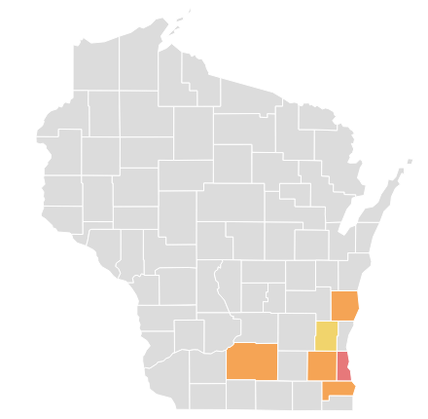
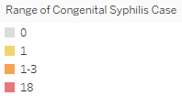
(n=25)
Milwaukee County Accounted for 72% of Reported Congenital Syphilis Cases in Wisconsin in 2023
Notes:
In 2023, congenital syphilis was reported in only 6 out of 72 counties, indicating that 66 (92% of total counties) counties had no reported cases. Milwaukee County alone accounted for over half of the reported cases. Most congenital syphilis cases were concentrated in the South and Southeastern Region of Wisconsin.

Slide 35
Gonorrhea
Notes:
Gonorrhea is the second most reported sexually transmitted infection in the state.

Slide 36
Gonorrhea was the Second Most Common Reported STI
A total of 7,005 cases of gonorrhea were reported in 2023.
Notes:
In 2023, a total of 7,005 cases of gonorrhea were reported reflecting a 20% decrease compared to 2022 (8,736 in 2022 to 7,005 in 2023).

Slide 37
Reported Gonorrhea Cases Decreased for the Third Consecutive Year in Wisconsin Five-year trend of reported cases of gonorrhea infection, Wisconsin, 2019–2023.
Notes:
This slide displays the reported cases of gonorrhea over the past five years in Wisconsin.
The reported cases of gonorrhea increased with the onset of COVID-19, then started to decline since 2021. The reported number of gonorrhea cases continued to trend downward for the second consecutive year (2021 and 2023).

Slide 38
The Gonorrhea Rate Has Also Decreased for the Third Year in Wisconsin Five-year rate trend of gonorrhea cases per 100,000 people in Wisconsin, 2019–2023
Notes:
This slide displays the rate of gonorrhea cases per 100,000 people over the past five years in Wisconsin.
The rate gonorrhea cases increased with the onset of COVID-19 and have been declining since 2021. The rate of gonorrhea cases continued to trend downward for the third consecutive year (2021-2023).

Slide 39
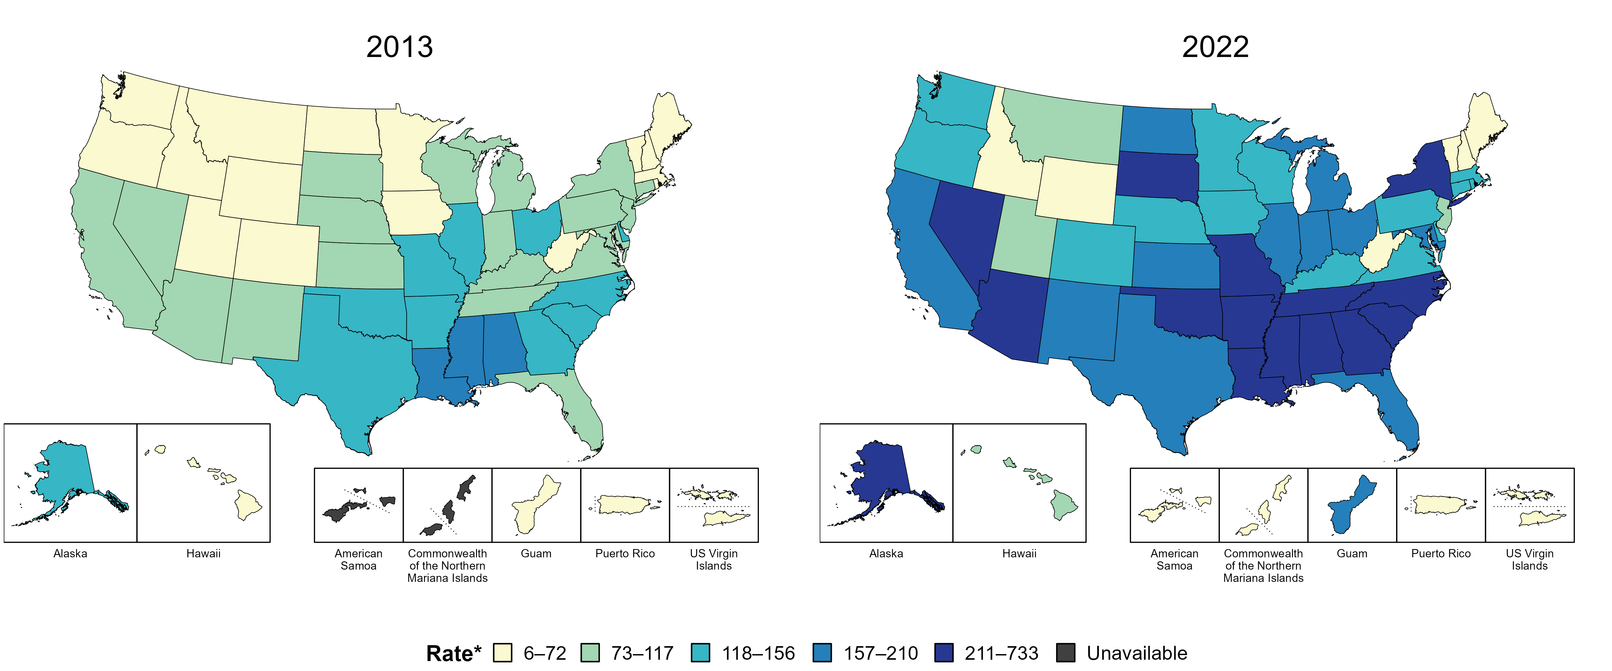
Gonorrhea — Rates of Reported Cases by Jurisdiction, United States and Territories, 2013 and 2022
* Per 100,000
Notes:
In 2013, three states and the District of Columbia (DC; 7.4% of areas with available data) had a rate of reported gonorrhea cases greater than or equal to 157 cases per 100,000 population. This increased to 26 states, DC, and one US territory (50.0% of areas with available data) in 2022.
American Samoa and the Commonwealth of the Northern Mariana Islands began reporting data on gonorrhea cases to CDC in 2018; data are not available for those areas prior to that year.
This slide includes data from years that coincide with the COVID-19 pandemic, which introduced uncertainty and difficulty in interpreting STI surveillance data.
See Technical Notes (https://www.cdc.gov/std/statistics/2022/technical-notes.htm) for information on gonorrhea case reporting and on interpreting reported rates in US territories.
Data for all figures are available at https://www.cdc.gov/std/statistics/2022/data.zip. The file “GC - Rates by Jurisdiction (US and Terr 2013 and 2022).xlsx” contains the data for the figure presented on this slide.

Slide 40
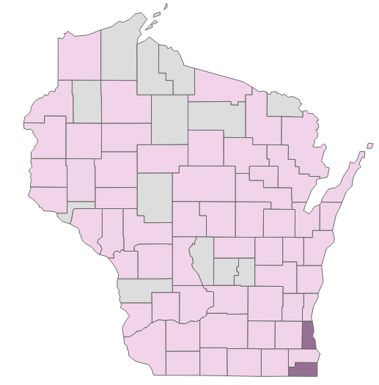
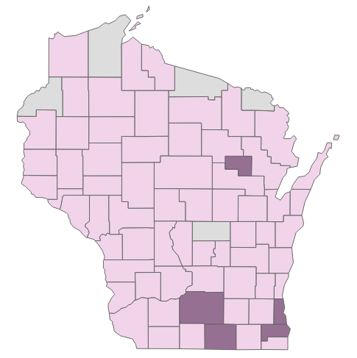
Since 2013, Gonorrhea has Spread to More Counties in Wisconsin
Gonorrhea rates of reported cases by County, 2013—2023
2013
2023
Notes:
Since 2013, the geographic spread of gonorrhea in Wisconsin has increased. In 2013, 59 out of 72 counties in Wisconsin had a gonorrhea rate of one or more cases per 100,000 people. By 2023, this number had risen to 67 counties. Over the past decade, the rate of gonorrhea increased 431% in Wisconsin.

Slide 41
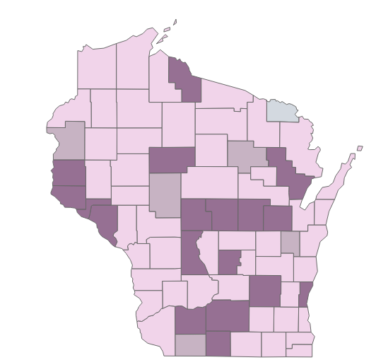
The Reported Number of Gonorrhea Cases Increased in 18 Wisconsin Counties from 2022 to 2023
Notes:
In 2023 compared to 2022:
25% (18/72) of Wisconsin counties, indicated by a dark purple color, showed an increase in reported gonorrhea cases.
67% (48/72) of Wisconsin counties, indicated by a light purple color, showed a decrease in reported gonorrhea cases.
7% (5/72) of Wisconsin counties, indicated by light brown color, showed no change in reported gonorrhea cases.
1% (1/72) of Wisconsin counties, indicated by a gray color, reported zero cases of gonorrhea in 2023.

Slide 42
Gonorrhea Rate Among Both Males and Females has Been Decreasing Since 2021 Number of gonorrhea diagnoses per 100,000 people by sex at birth, Wisconsin 2019–2023
Male
Female
Notes:
This slide displays the reported case rates of gonorrhea trends among Wisconsin males and females for past five years.
In 2023, gonorrhea rates remained higher among men then women, with males having a rate 1.2 times higher than females. However, both genders experienced a decrease in gonorrhea rates compared to 2022, with a 23% reduction among females and 18% reduction among males. This decline continues a downward trend in gonorrhea rates observed since 2021 for both men and women.

Slide 43
Overall Trend of Gonorrhea by Age Groups Trend of gonorrhea diagnoses per 100,000 people by age at diagnosis in Wisconsin, 2019–2023
15–19
years
20–24
years
25–29
years
30–39
years
Notes:
This slide illustrates gonorrhea rates across different age groups in Wisconsin for past five years. Traditionally, younger age groups have exhibited higher gonorrhea rates. There was an increase in gonorrhea rates coinciding with the onset of COVID-19. However, from 2021 to 2023 gonorrhea rates decreased across almost all age groups, with most significant reduction observed in people aged 20-24 years.

Slide 44
In 2023, the Incidence of Gonorrhea was Slightly Higher Among Females Aged 15–24 Years Than Males the Same Age
Male
Age
Female
Notes:
This slide illustrates gonorrhea rates across different age groups and sexes in Wisconsin for past five years.
Among both genders, the younger age groups have exhibited higher gonorrhea rates compared to the older age groups.

Slide 45
Gonorrhea Rates Have Been Declining Across all Races and Ethnicities since 2019 Rates of gonorrhea diagnoses per 100,000 people by race/ethnicity, 2019–2023
Black
Hispanic
White
Notes:
This slide displays the reported case rates of gonorrhea trends among racial ethnic groups for past five years in Wisconsin.
As in previous years, racial disparities in the rate of reported gonorrhea cases were observed in 2023. The rate of reported cases of gonorrhea among Black people were 8.9 times higher than Hispanic people and 34.2 times higher than white people in 2023. However, all racial ethnic groups experienced a decrease in gonorrhea rates compared from 2022 to 2023, with a 15% reduction among Black people, 30% reduction among Hispanic people, and 21% reduction among white people.

Slide 46
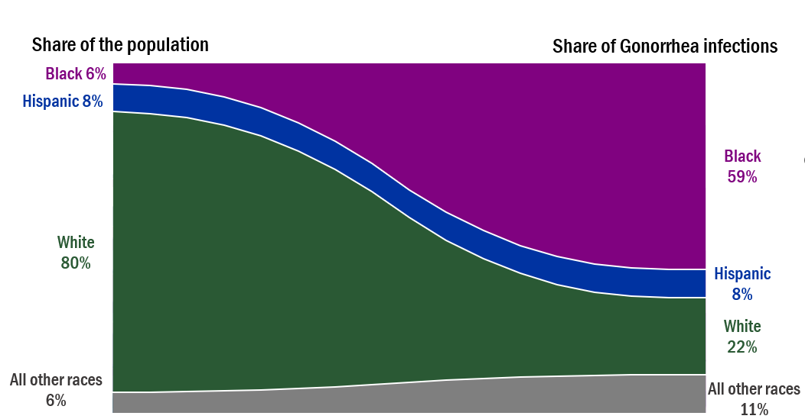
Gonorrhea Does Not Impact People of All Races and Ethnicities Equally
Notes:
The slide highlights the disproportionate burden of gonorrhea infections among racial and ethnic groups in Wisconsin. Despite representing only 6% of the total population, Black people accounts for more than half of reported (59%) gonorrhea infections. Conversely, White people, who constitute 80%of the population, exhibits only 22% burden of gonorrhea infections.

Slide 47
Chlamydia
Notes:
Chlamydia is the most reported sexually transmitted infection in the state.

Slide 48
Chlamydia is the Most Commonly Reported STI
A total of 24,992 cases of chlamydia were reported in Wisconsin in 2023.
Notes:
In 2023, a total of 24,992 cases of chlamydia were reported reflecting a 2.6% decrease compared to 2022 (25,647cases).

Slide 49
The Reported Number of Chlamydia Cases Decreased for the Third Consecutive Year
Five-year trend of reported cases of chlamydia infection in Wisconsin, 2019–2023.
Notes:
This slide presents the reported cases of chlamydia over the past five years in Wisconsin.
In 2020, the reported cases of chlamydia decreased by 11.9% compared to 2019, likely due to the impact of COVID-19. The number cases rebounded in 2021 but have been declining since then. The downward trend in reported chlamydia cases has continued for three consecutive years (2021 and 2023).

Slide 50
Rate of Reported Chlamydia Cases Have Been Decreasing for the Last Three Years
Five-year rate (per 100,000 people) trends of reported cases of chlamydia in Wisconsin, 2019–2023.
Notes:
This slide presents the rates of chlamydia over the past five years in Wisconsin.
In 2020, the rate of reported cases of chlamydia decreased by 15% compared to 2019, likely due to the impact of COVID-19. The rate returned to normal in 2021 but have been declining since then. The downward trend in reported rate has continued for three consecutive years (2021 and 2023).

Slide 51
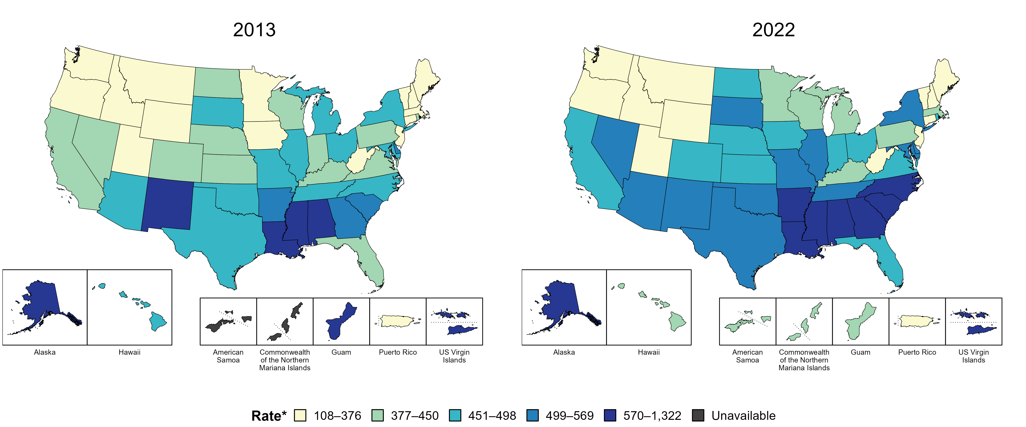
Chlamydia — Rates of Reported Cases by Jurisdiction, United States and Territories, 2013 and 2022
* Per 100,000
Notes:
In 2013, nine states, the District of Columbia (DC), and two US territories (22.2% of areas with available data) had a rate of reported chlamydia greater than or equal to 499 cases per 100,000 population. This increased to 20 states, DC, and one US territory (39.3% of areas with available data) in 2022.
American Samoa and the Commonwealth of the Northern Mariana Islands began reporting data on chlamydia cases to CDC in 2018; data are not available for those areas prior to that year.
This slide includes data from years that coincide with the COVID-19 pandemic, which introduced uncertainty and difficulty in interpreting STI surveillance data.
See Technical Notes (https://www.cdc.gov/std/statistics/2022/technical-notes.htm) for information on chlamydia case reporting and on interpreting reported rates in US territories.
Data for all figures are available at https://www.cdc.gov/std/statistics/2022/data.zip. The file “CT - Rates by Jurisdiction (US and Terr 2013 and 2022).xlsx” contains the data for the figure presented on this slide.

Slide 52
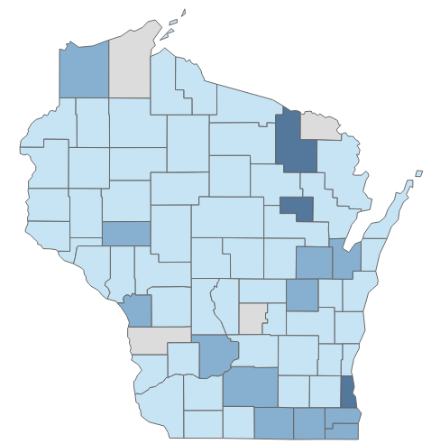
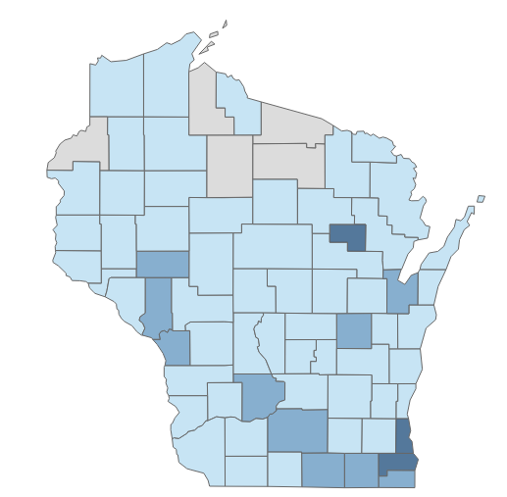
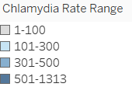
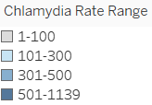
Since 2013, Chlamydia has Spread to More Counties in Wisconsin
2013
2023
Notes:
Since 2013, the geographic distribution of chlamydia in Wisconsin has remained relatively stable. In 2013, 15 out of 72 counties in Wisconsin reported a chlamydia incidence rate of 300 or more cases per 100,000 people. By 2023, this number decreased to 13 counties. Over the past decade, the incidence rate of chlamydia in Wisconsin has shown minimal variation.

Slide 53
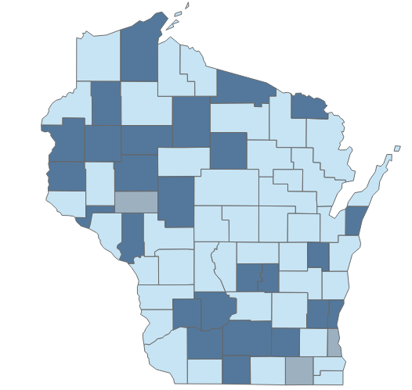
The Reported Number of Chlamydia Cases Increased in 26 Wisconsin Counties from 2022 to 2023
Notes:
In 2023 compared to 2022:
36% (26/72) of Wisconsin counties indicated by a dark blue color showed an increase in reported chlamydia cases.
60% (43/72) of Wisconsin counties indicated by a light blue color showed an increase in reported chlamydia cases.
4% (3/72) of Wisconsin counties indicated by a gray color showed no change in reported chlamydia cases.

Slide 54
Chlamydia Rates have Historically Been Higher Among Females Compared to Males Rates of chlamydia diagnoses per 100,000 people by sex, 2019—2023
Female
Male
Notes:
This slide displays the reported case rates of chlamydia trends among Wisconsin males and females for past five years.
In 2023, chlamydia rates remained higher among women then men, with females having a rate 1.9 times higher than males. However, both genders experienced a decrease in chlamydia rates compared to 2022, with a 3.6% reduction among females and 2.3% reduction among males. This decline continues a downward trend in chlamydia rates observed since 2019 for both men and women.

Slide 55
Overall Trend of Chlamydia by Age Groups Trend of chlamydia diagnoses per 100,000 people by age at diagnosis in Wisconsin, 2019–2023
15–19
years
20–29
years
30–39
years
40–49
years
Notes:
This slide illustrates chlamydia rates across different age groups in Wisconsin for past five years .
Younger age groups have a higher incidence of chlamydia. However, from 2021 to 2023 chlamydia rates decreased significantly among people aged 20-29 years.

Slide 56
The Incidence of Chlamydia was Higher Among Females Than Males Aged 20–29 years in 2023 Chlamydia case distribution by age and sex in Wisconsin, 2023
Male
Female
Notes:
This slide illustrates chlamydia rates across different age groups and sexes in Wisconsin for 2023.
The incidence of chlamydia was higher among females compared to males. Chlamydia tends to occur more often among young females than young males. The chlamydia rate was 2.7 times higher among females aged 20–29 compared to males in the same age group.

Slide 57
The Rate of Chlamydia Infections Increased Among Black People from 2022–2023 Rates of chlamydia diagnoses per 100,000 people by race/ethnicity, 2019–2023
Black
Hispanic
White
Notes:
This slide shows the rates of chlamydia diagnoses per 100,000 people by race/ethnicity in Wisconsin between 2019–2023.
Black people continue to be disproportionately affected by chlamydia. The rate of chlamydia infections increased among Black people from 2022–2023 while decreasing among white and Hispanic people.

Slide 58
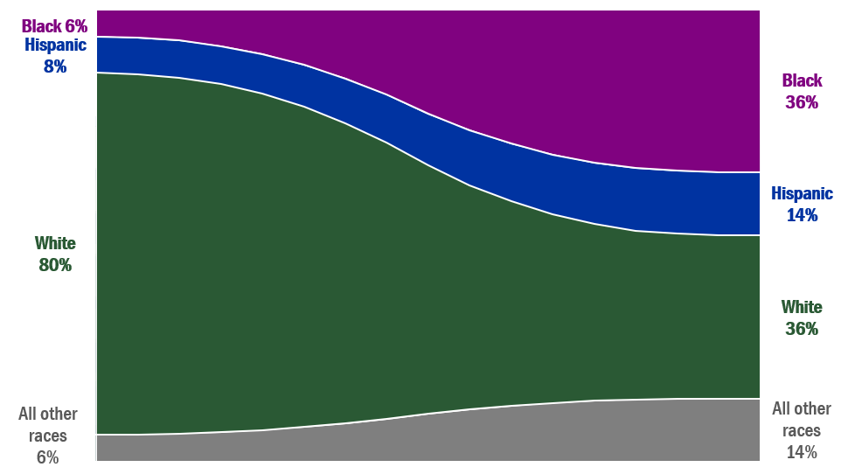
Chlamydia Does Not Impact People of All Races and Ethnicities Equally
Share of the population
Share of chlamydia infections
Notes:
The slide highlights the disproportionate burden of chlamydia infections among racial and ethnic groups in Wisconsin. Despite representing only 6% of the total population, Black people accounts for 36% of chlamydia infections. Conversely, white people, who constitute 80% of the population, also account for 36% of chlamydia infections.

Slide 59
Key Takeaways From 2023 Data:
The rate of primary and secondary syphilis cases decreased among Black people for the first time in 2019.
Reported cases of STIs decreased from 2022 to 2023.
Of the three STIs, gonorrhea cases decreased the most at 20%.
Notes:
Gonorrhea and Chlamydia rates have been decreasing since 2021. Syphilis decreased in 2023 compared to 2022.

