Slide 1
Lead-Safe Renovation in Wisconsin
Presented by [Insert Training Company Name]
Notes:
The following rules apply in Wisconsin, in addition to the federal rules. Allows follow the more stringent rules.

Slide 2
Wisconsin’s additional requirements
Differences from U.S. Environmental Protection Agency (EPA) requirements

Slide 3
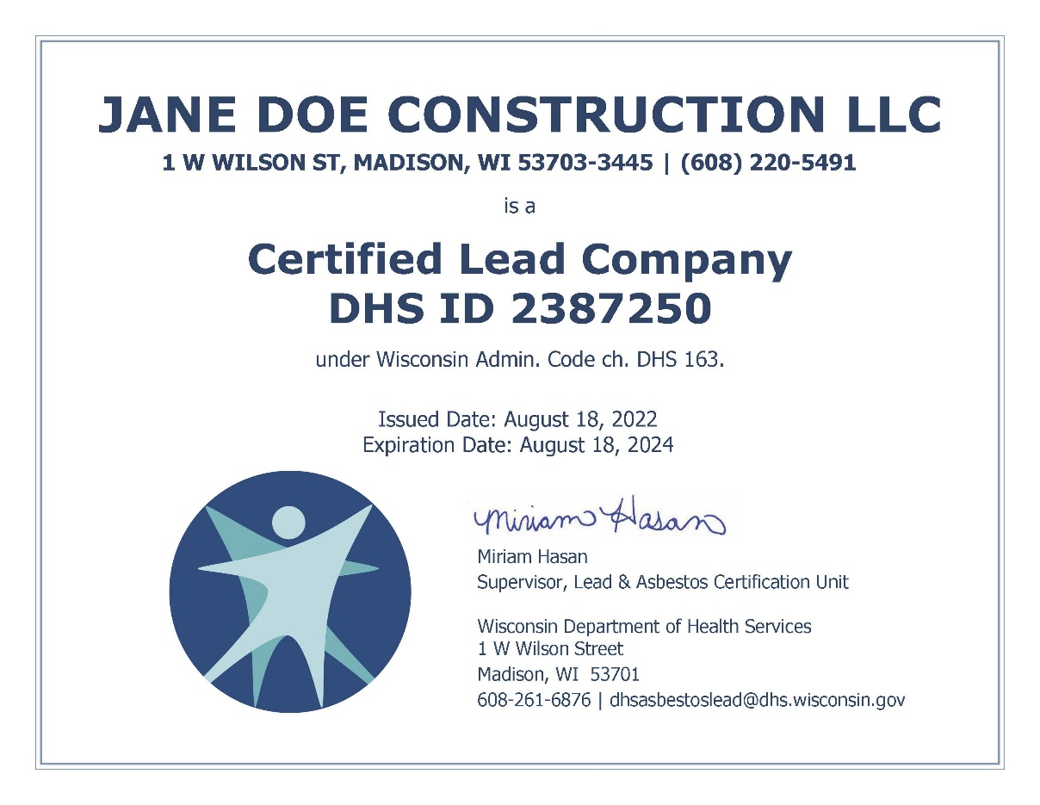
Company and individual certification are required for renovations in Wisconsin.
Notes:
You need individual and company certification from the DHS for Wisconsin renovations.
This even applies for sole proprietors (owner-operators). It’s like having your driver’s license and your vehicle registered.
Even if you already have an EPA-certified firm, your company needs Wisconsin certification.
The images are not to scale. The individual certification card with photo is credit-card sized. The company certificate is printed on 8.5" x 11" paper.

Slide 4
Company certification
You can either:
work for a DHS-certified Lead Company, or
apply to DHS for Lead Company certification (for either two or four years).
To stay certified, apply to renew your company before the expiration date.
Duration | Fee
Two years | $125
Four years | $250

Slide 5
Individual certification
After training, apply to DHS for Lead-Safe Renovator certification (for either two or four years).
To stay certified, apply to renew before your certification expires. Take in-person refresher training every four years to remain eligible.
Duration | Fee
Two years | $75
Four years | $150
Keep your certification card (or a photo of it) with you when doing renovation work.
Notes:
You don't have to apply to EPA for certification as an individual renovator. But in Wisconsin, you must apply to DHS to be a Lead-Safe Renovator.
Wisconsin doesn’t accept online-only refresher training. You need hands-on renovator training every four years.

Slide 6
Interim controls to protect a lead-poisoned child
When interim controls to protect a lead-poisoned child include renovation activities, follow all renovation requirements—including distributing the Renovate Right pamphlet.
Notes:
Interim controls temporarily reduce lead hazards. Some interim controls are regulated renovation activities. One common example is scraping loose paint from a surface to repaint.
Even though it is important to act fast to protect a child from exposure to lead, interim controls are not considered emergency renovations in Wisconsin. That means that all requirements for these jobs still apply.
This is different from EPA, which waives the requirement to give the Renovate Right pamphlet out in advance of interim controls in response to a poisoned child.
WI only defines “Emergency renovation” as “renovation activities that were not planned but result from a sudden, unexpected event, that, if not immediately attended to, presents a safety or public health hazard, or threatens equipment or property with significant damage.”

Slide 7
Wisconsin has dust clearance standards for window troughs (wells) and porches.
 | EPA Dust Clearance Standards | Wisconsin Dust Clearance Standards
Floor | Less than 10 | Less than 10
Sill | Less than 100 | Less than 100
Trough (well) | Less than 400 | Less than 100
Porch | N/A | Less than 40
All levels in micrograms per square foot (μg/ft²)
Notes:
EPA doesn’t have dust clearance standards for window troughs or porches. Wisconsin does.

Slide 8
A Wisconsin renovation requires a written contract.
The contract must:
Comply with Wis. Admin. Code § ATCP 110.05,
Specify the activities to be performed, and
include information about the presence or absence of bonding or insurance coverage (including workers compensation insurance).
For post-renovation clearance (instead of cleaning verification), also include who is responsible for the costs of additional cleaning and clearance tests if the project fails clearance.
Notes:
The federal regulation does not require a contract for a renovation project.
For information on Wis. Admin. Code § ATCP 110.05, visit DATCP Home Consumer Protection (wi.gov).

Slide 9
Wisconsin post-renovation reports have three main differences from EPA.
1. They are due earlier—within 10 working days of finishing the renovation.
Notes:
EPA allows 30 days from finishing the renovation to give out the post-renovation report. In Wisconsin, you have 10 working days (two full weeks).

Slide 10
Wisconsin post-renovation reports have three main differences from EPA.
1. They are due earlier—within 10 working days of finishing the renovation.
2. The full report—not just instructions for requesting the report—must be given to an adult occupant of any affected dwelling unit.
Notes:
EPA only requires you to tell the adult occupant how to request the report. Wisconsin requires you to give an adult occupant of each affected unit the full report.

Slide 11
Wisconsin post-renovation reports have three main differences from EPA.
1. They are due earlier—within 10 working days of finishing the renovation.
2. The full report—not just instructions for requesting the report—must be given to an adult occupant of any affected dwelling unit.
3. The written contract for the renovation must be included.
Notes:
Unlike EPA, Wisconsin requires a written contract for a renovation.
Wisconsin post-renovation reports must also have a copy of the written contract.

Slide 12
Wisconsin’s prohibited practices
Actions that are not allowed in Wisconsin

Slide 13
NO paint chip sampling without additional certification
Certification as a lead risk assessor, hazard investigator, or inspector is required for paint chip sampling in Wisconsin.
Notes:
EPA allows renovators to collect paint chip samples. Wisconsin does not.
Even though you learned about paint chip sampling, you cannot collect paint chip samples in Wisconsin.
Paint chip sampling is difficult. Wisconsin requires more training to do it.

Slide 14
NO paint strippers with methylene chloride
Notes:
Do not use chemical paint strippers with methylene chloride. EPA is working on banning this ingredient. It can cause cancer and, when used in confined spaces, death.

Slide 15
NO pressure or power washing to remove paint without full containment and water filtration
Notes:
Wisconsin doesn’t allow high pressure water blasting, power washing, or hydroblasting unless it is conducted in a fully contained work area with HEPA-filtered exhaust control and water collection system.

Slide 16
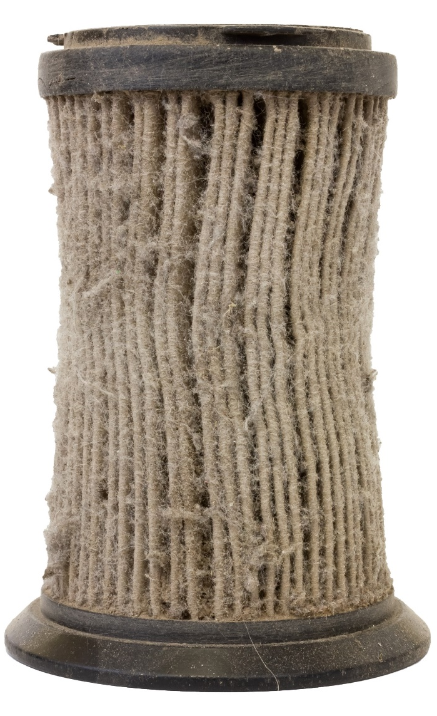
NO vacuuming with improperly operating equipment
Don’t use a high-efficiency particular air (HEPA) vacuum with hose damage, a clogged or missing filter, loose connections, or other problems.
Notes:
HEPA vacuums may not be operated if any of the filters or bag are missing or damaged; the hose has cracks, is otherwise damaged or has been altered in any way; or the seams and seals are no longer providing a proper fit.

Slide 17
NO dry sweeping dust, debris, or paint chips
Notes:
No dry sweeping. Keep brooms out of work area until lead work is done and cleaned up.

Slide 18
Contact DHS with any questions.
608-261-6876
DHSAsbestosLead@dhs.Wisconsin.gov

